Slide 1
Programming for Engineers in Python
Fall 2019-2020
Recitation 9:
Object Oriented Programming 2

Slide 2
OOP1 – Recap:
Objects
Objects are natural to us: everything in one place
Hold data (in most cases)
May be manipulated
Provide services (in most cases)
OBJECT
ATTRIBUTE
Define state of the object
METHOD
Define function

Slide 3
Classes - example
class Point:
def __init__(self, x, y):
self.x = x
self.y = y
Usage example:
>>> p = Point(3,2)
>>> p.x
3
>>> p.y
2
p
3
2

Slide 4
Classes – Attributes and Methods
Reminder: str
In order to apply a Method to a string:
>>> s = "ABC"
>>> s.lower()
'abc'
class str:
⁞
def lower(self):
⁞

Slide 5
Classes – Attributes and Methods
class Point:
def __init__(self, x, y):
...
def distance_from_axes_origins(self):
...
def distance_from_other_point(self, other):
...

Slide 6
Classes – Instantiate and Use
>>> p1 = Point(1, 0)
>>> p2 = Point(0, 1)
>>> distance_from_other_point(p1,p2)
Traceback (most recent call last):
File "<pyshell#7>", line 1, in <module>
distance_from_other_point(p1,p2)
NameError: name 'distance_from_other_point' is not defined
>>> p1.distance_from_other_point(p2) # Call method on instance
1.4142135623730951

Slide 7
Plan
LUD(Least used dictionary)
Hamming Distance
Gene Class
Machine Parts

Slide 8
Least used dictionary
Our objective is to implement a bounded size dictionary that keeps track on the number of times an element is accessed.
By accessed we mean getting the value of the key, i.e., get(key).
When the dictionary is full, and the user tries to add a new (key, value), the class will check the least accessed key and will remove it from the dict. Only after that, we add the new key to the dictionary.

Slide 9
Least used dictionary
The methods we will implement are:
__init__(self, memory_size):
Initiates our dictionary, and sets it maximal size to memory_size.
If memory_size is smaller than 1, raise ValueError.
__len__(self):
Returns the number of elements in the LUD.
__contains__(self, key):
Returns True if there key is in the dictionary.
get(self, key):
Returns the value of the key, moreover, it updates the counter. If key not exists in the dictionary, the method returns none.
put(self, key, value):
Adds a new key, value element to the dictionary.
Notes:
Like all special methods (with "magic names" that begin and end in __), __contains__ is not meant to be called directly (except in very specific cases, such as up=calls to the superclass): rather, such methods are called as part of the operation of built-ins and operators. In the case of __contains__, the operator in question is in -- the "containment check" operator.

Slide 10
code
class LUD:
def __init__(self, memory_size):
if memory_size < 1:
raise ValueError('Error memory size')
self.memory_size = memory_size
self.data = {}
self.usage = {}
def __len__(self):
return len(self.data)
def __contains__(self, key):
return key in self.data
#TODO
Called when len() is applied to LUD
#TODO
Called when key in LUD expression is evaluated
#TODO

Slide 11
code
def extract_value(key_value):
return key_value[1]
class LUD:
...
def get(self, key):
val = self.data.get(key)
if val != None:
self.usage[key] += 1
return val
def put(self, key, value):
if len(self) == self.memory_size and key not in self:
mkey, mval = min(self.usage.items(), key=extract_value)
self.data.pop(mkey)
self.usage.pop(mkey)
self.data[key] = value
self.usage[key] = 0
Outside class definition.
Doesn’t get “self”
#TODO
#TODO
and key not in self:

Slide 12
Usage example
lud_dict = LUD(2) lud_dict.put('Hi', 2) lud_dict.put('Bye', 2) a = lud_dict.get('Hi') lud_dict.put('Hi again', 1) print('Bye' in lud_dict) print('Hi' in lud_dict)
What is printed?
False
True
What function was called when we used in?
__contain__ !

Slide 13
Plan
Vector class (OOP, operator overloading)
Hamming Distance
Gene Class
Machine Parts

Slide 14
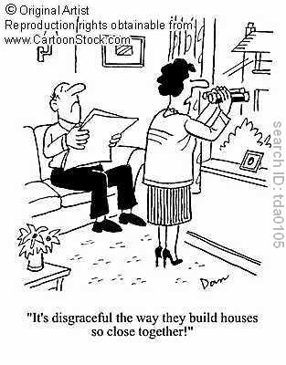
String similarity
Given two strings of the same length, how close to each other are they?
How can we define distance between strings?

Slide 15
String Distance Function
A string distance function d should measure the difference between two strings s1, s2.
d(s1, s1)=0 (perfectly similar).
But how much is d(s1, s2) ?
d can then be used for spell checking – we replace a word with an error with the closest correct word in the dictionary
'hello'
'hallo'
‘billy'
‘jello'

Slide 16


Hamming Distance
http://en.wikipedia.org/wiki/Hamming_distance
Use the number of positions at which the corresponding symbols are different
Examples:

Slide 17
Hamming Distance Implementation
def hamming_distance(w1, w2):
if len(w1) != len(w2):
raise ValueError("cannot measure distance")
dist = 0
for i in range(len(w1)):
if w1[i] != w2[i]:
dist += 1
return dist
>>> hamming_distance('hallo', 'hello')
1
>>> hamming_distance('hallo', 'billy')
3
>>> hamming_distance('hallo', 'queen')
5
>>> hamming_distance('hallo', 'king')
Traceback (most recent call last):
…
ValueError: cannot measure distance

Slide 18
Plan
Vector class (OOP, operator overloading)
Hamming Distance
Gene Class
Machine Parts

Slide 19

Gene Class
A gene is a sequence of the letters A,C,G,T
Create a class Gene to represent a gene
Implement __init__ , __repr__ , __len__:
>>> Gene('A Gc tGTCAa GTC')
AGCTGTCAAGTC
>>> len(Gene('A Gc tGTCAa GTC'))
12
Input to __init__ is a string
Should remove spaces, and convert to upper case
Should validate input (only ACGT are allowed)
__repr__ should return the gene as a string
__len__ should return the number of letters

Slide 20
Gene Class – Constructor
Input to __init__ is a string
Should remove spaces, and convert to upper case
Should validate input (only ACGT are allowed)
class Gene:
def __init__(self, seq):
seq = seq.replace(' ', '')
seq = seq.upper()
self.seq = seq
if not self.is_valid():
raise ValueError('Invalid sequence!')
>>> Gene('AGc tGT CAa GTC')
AGCTGTCAAGTC

Slide 21
Gene Class – is_valid
class Gene:
def __init__(self, seq):
self.seq = seq.replace(' ','').upper()
if not self.is_valid():
raise ValueError('Invalid sequence!')
def is_valid(self):
bases = 'ACGT'
for c in self.seq:
if c not in bases:
return False
return True

Slide 22
Gene Class – __repr__ and __len__
>>> Gene('AGc tGT CAa GTC')
AGCTGTCAAGTC
>>> len(Gene('AGc tGT CAa GTC'))
12
__repr__ should return the gene as a string
__len__ should return the number of letters
class Gene:
…
def __repr__(self):
return self.seq
def __len__(self):
return len(self.seq)

Slide 23
Gene Class – distance
Implement a distance method that returns Hamming distance between genes
>>> a = Gene('TGT CAA GTC')
>>> b = Gene('TCT CTG GTA')
>>> a.distance(b)
4
class Gene:
…
def distance(self, other):
if len(self) != len(other):
raise ValueError("cannot measure distance")
dist = 0
for i in range(len(self)):
if self.seq[i] != other.seq[i]:
dist += 1
return dist

Slide 24
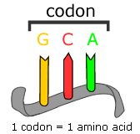
Gene Class – Codons
Genes are composed of 3-letter codons
is_valid should verify:
The gene contains whole codons
The gene starts with the start codon: ATG
The gene ends with a stop codon: TAG, TAA or TGA
The gene does not contain another stop codon.

Slide 25
class Gene:
…
def is_valid(self):
bases = 'ACGT'
start_codon = 'ATG'
stop_codons = ['TAG','TGA','TAA']
# check only legal characters
for c in self.seq:
if c not in bases:
return False
if len(self) % 3 != 0:
return False
if self.seq[:3] != start_codon:
return False
if self.seq[-3:] not in stop_codons:
return False
for i in range(0, len(self) - 3, 3):
if self.seq[i:i+3] in stop_codons:
return False
return True
# check length divides by 3
# check start codon
# check stop codon
# check no stop # codons in the # middle
# reached here? seq is valid!!!

Slide 26
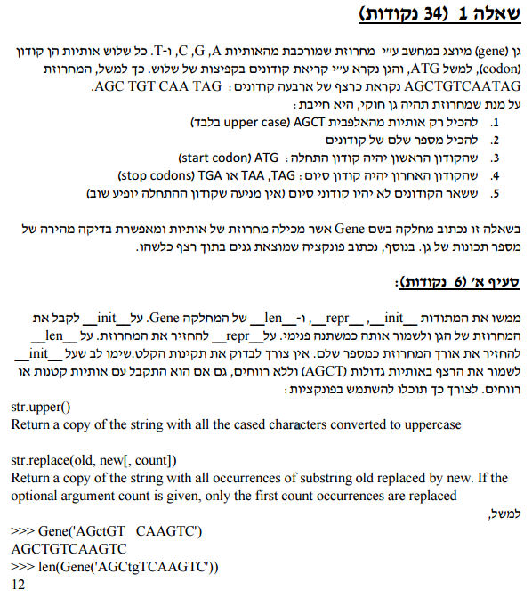

Slide 27
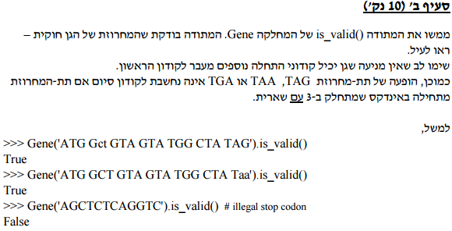
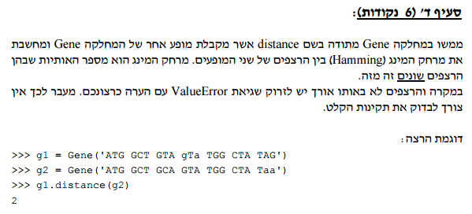

Slide 28
Plan
Vector class (OOP, operator overloading)
Hamming Distance
Gene Class
Machine Parts

Slide 29

Moed B exam- Fall 2015

Slide 30
Moed B exam- Fall 2015
Question 1 (33 points)
In this question, you will implement classes related to machine parts.
Part A (6 points)
The class TRange represents a range of temperatures. The class contains two fields that represent the minimal and the maximal temperatures in the range (both these temperatures are also included in the range). Temperatures are represented by integer numbers. Implement the methods __init__ and __repr__ of the class TRange. __init__ should receive the two extremities of the range and should save them as attributes in the object. __repr__ should return a string that represents the range. The string will contain the two extremities of the range, separated by a comma, and contained within “<” and “>” signs. For example: <15,25>. For the moment, we do not require checking the validity of the input data.

Slide 31
class TRange:
def __init__(self, min_temp, max_temp):
self.min_temp = min_temp
self.max_temp = max_temp
def __repr__(self):
return "<" + str(self.min_temp) + "," +
str(self.max_temp) + ">"

Slide 32
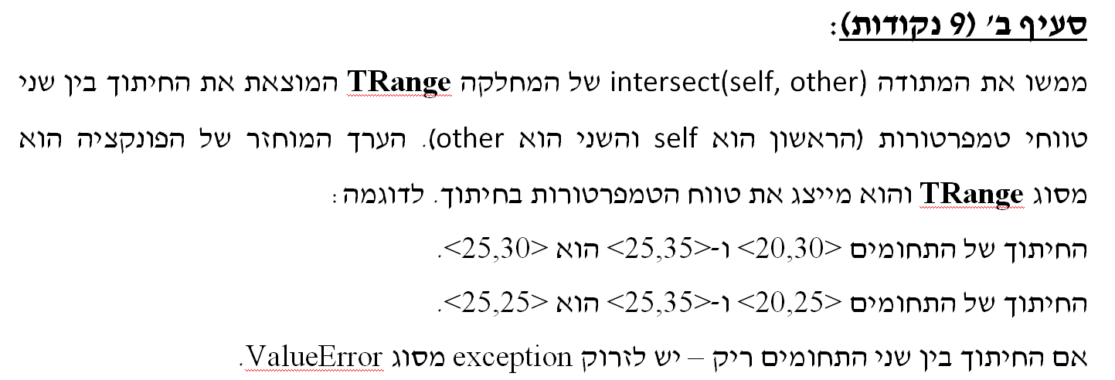

Slide 33
Part B (9 points)
Implement the method intersect(self, other) of the class TRange. This method finds the intersection of the ranges self and other. The value returned by the method is of type TRange and represents the intersection.
For example:
The intersection between <20,30> and <25,35> is <25,30>.
The intersection between <20,25> and <25,35> is <25,25>.
If the intersection between the two ranges is empty, you should raise an exception of type ValueError.

Slide 34
def intersect(self, other):
min_temp_result = max(self.min_temp, other.min_temp)
max_temp_result = min(self.max_temp, other.max_temp)
if min_temp_result > max_temp_result:
raise ValueError('No intersection!')
return TRange(min_temp_result, max_temp_result)

Slide 35
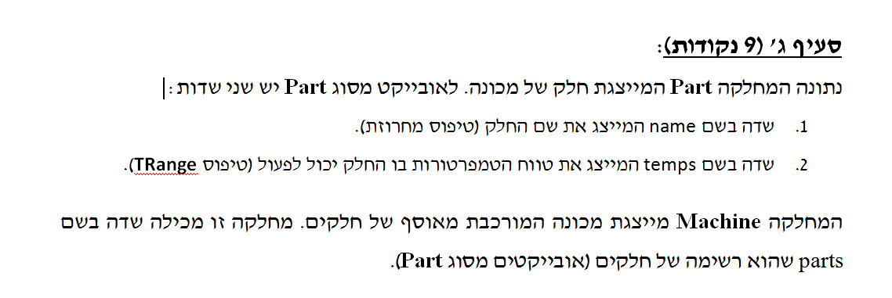
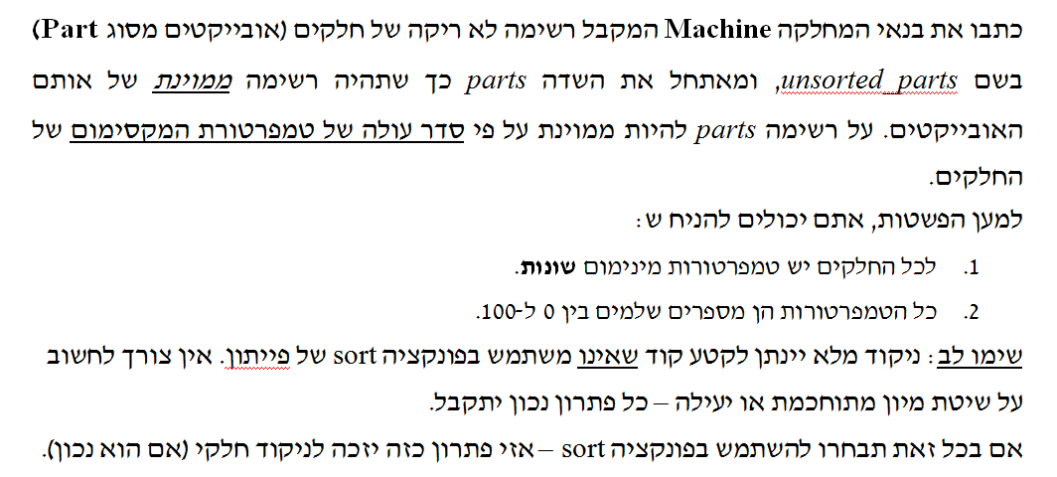

Slide 36
Part C (9 points)
You are given a class Part which represents a part of a machine. Objects of type Part have two attributes:
name: represents the name of the part (type string)
temps: represents the range of temperatures between which the part can function properly (type TRange)
The class Machine represents a machine made of a collection of parts. The class contains an attribute called parts which is a list of parts (objects of type Part).
Write the constructor of the class Machine which receives a non-empty list of parts (objects of type Part) called unsorted_parts and initializes the attribute parts which will be a sorted list containing the same objects. The list parts should be sorted according in increasing order according to the maximum temperature of the parts.

Slide 37
In order to simplify things, you can assume that:
All the parts have different minimum temperatures
All the temperatures are integers between 0 and 100
Note: a full grade will be given to code that does not use Python’s sort function. You do not need to devise a complicated or efficient sorting procedure. Every solution that works will be accepted. If you choose to use the function sort anyway, your solution will receive a partial grade (if it works).

Slide 38
class Machine:
def __init__(self, unsorted_parts):
self.parts = []
last_part_max_temp = -1
next_part = None
for index in range(len(unsorted_parts)):
next_max_temp = 101
for part in unsorted_parts:
# Analyze all parts that are not yet sorted
if part.temps.max_temp > last_part_max_temp:
# Update possible next part
if part.temps.max_temp < next_max_temp:
next_max_temp = part.temps.max_temp
next_part = part
self.parts.append(next_part)
last_part_max_temp = next_part.temps.max_temp

